Slide 1

FindiFox
Tech Update
05/11/2025
Dr Karsten Pedersen

Slide 2
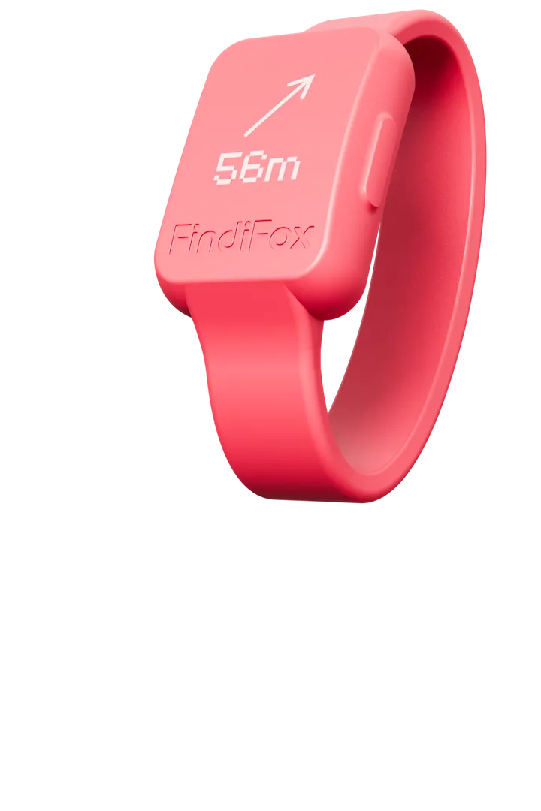
What we are working towards
Tracking device
  Low power
  Low cost
  Small
App counterpart
  Portable
  Unencumbered
  AR
Server
  Handle enough clients
  Aggregate data
  “AI”

Slide 3
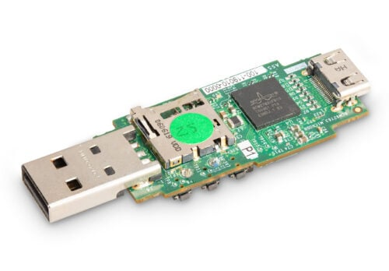
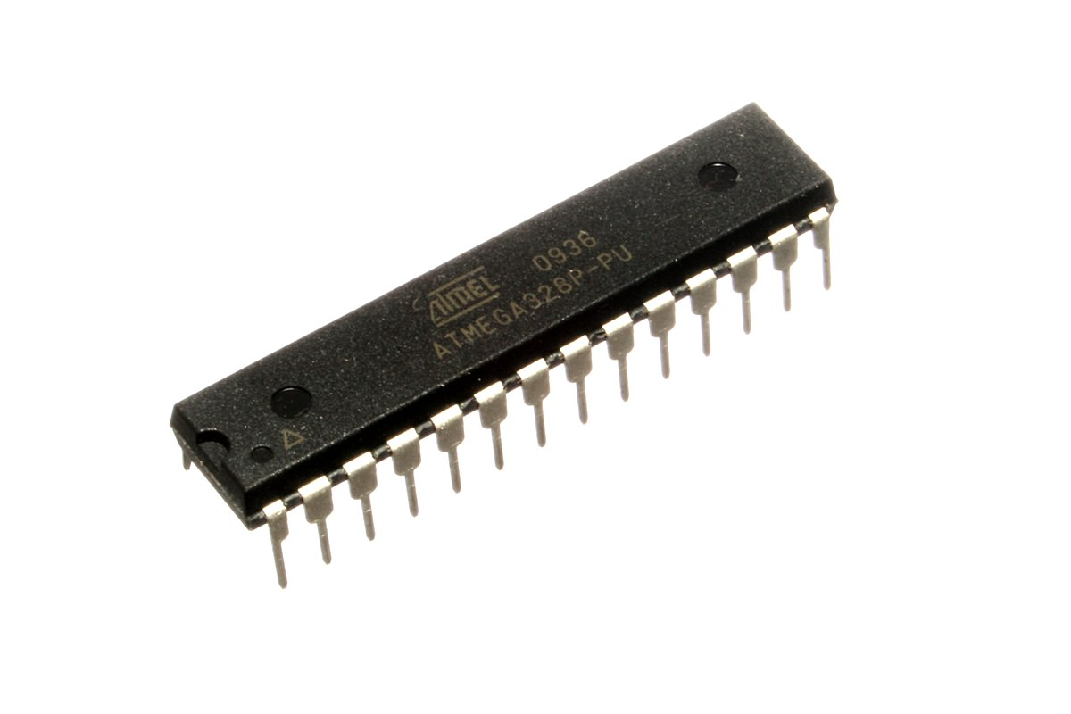
Where we are at so far
Tracking device
  BCM2710A1 based device
  AVR ATmega328P based device
App counterpart
  Web diagnostics frontend
  Web WebGL 3D frontend
  Unity ARCore frontend
  Android(+) OpenGL + ImGui frontend
  Android(+) Flutter frontend
Server
  Thames Software Proxy

Slide 4
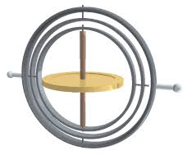
What are our current capabilities?
Detect if the tracker has gone outside range of app
Detect if the tracker has turned upside down (gimbal lock!)
Detect if tracker goes through door (low accuracy pressure)
Detect where the tracker is in Lat/Lon + Cartesian
Framework to create some outdoor mini games
Connect family phones together on a local network

Slide 5
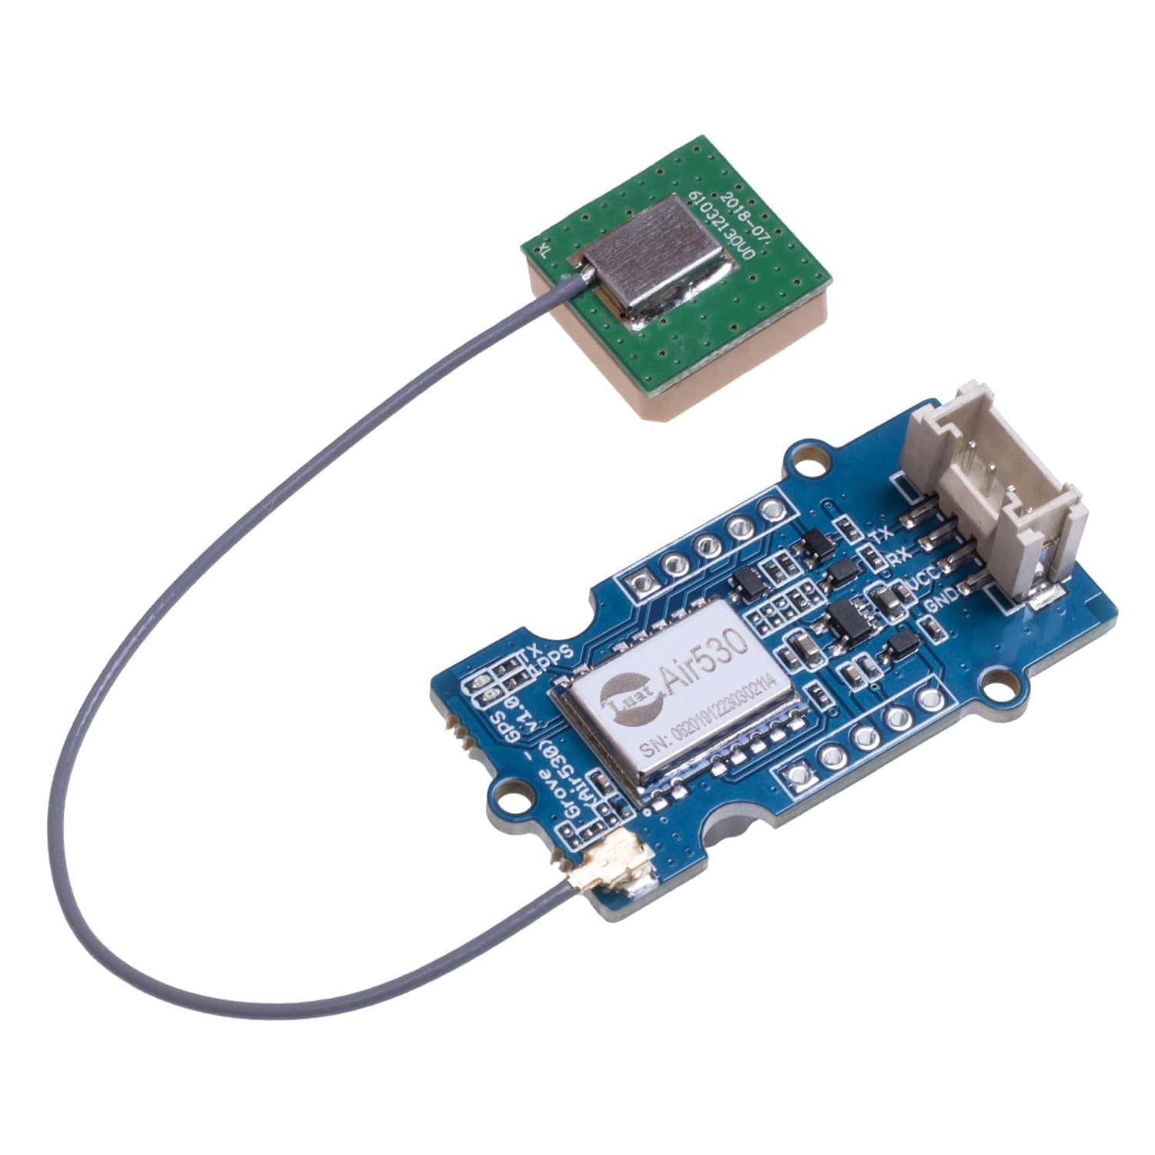
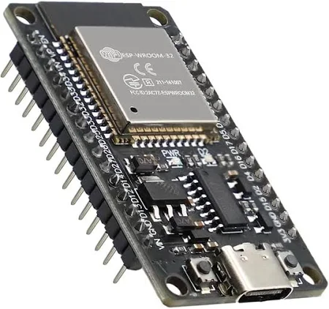
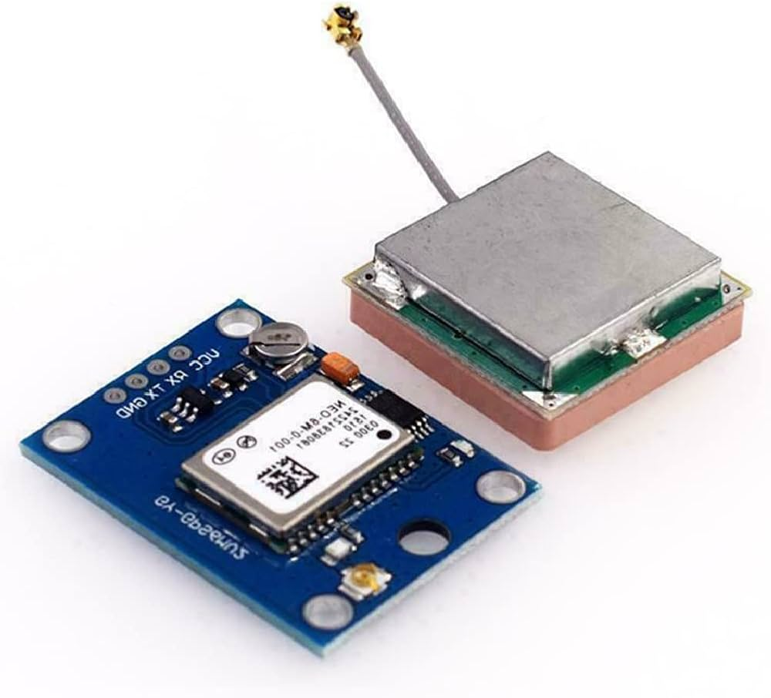
What we have explored
GPS
  NEO-6M
  Air530
GUI
  ImGui
AR
  ARCore (Unity wrapper)
  ARCore (upstream)
GSM
  SIM800l (£8)
  SIM7600E-H (£88)
  ESP32

Slide 6
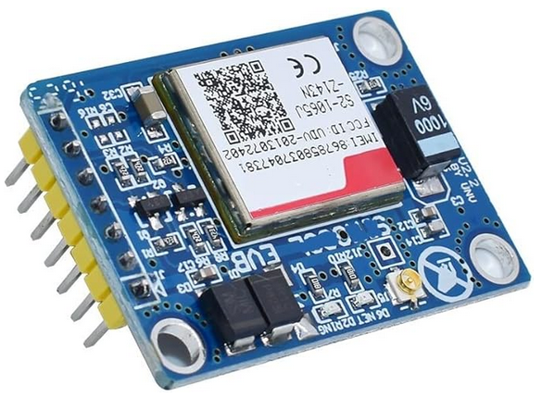
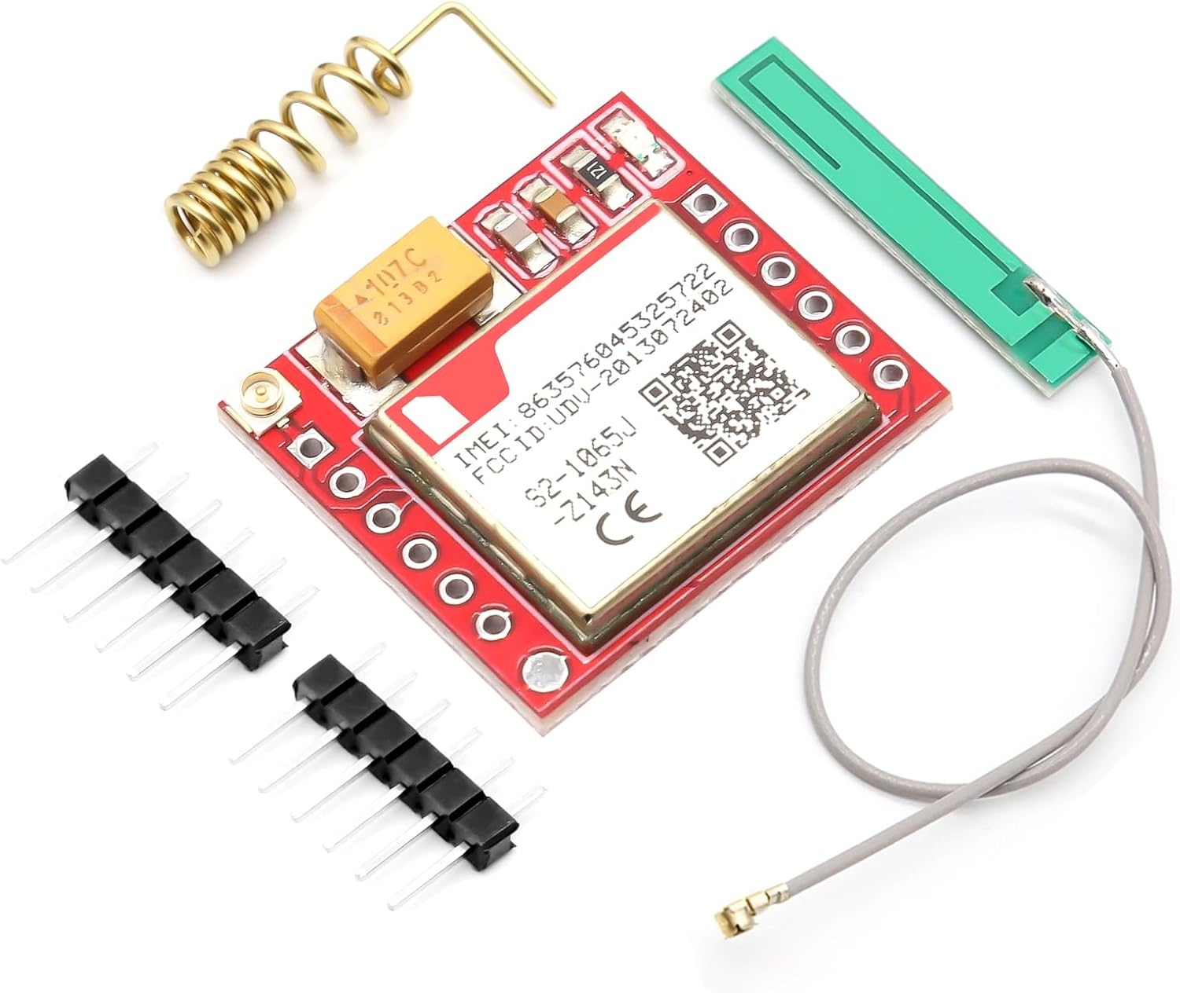
Unknowns
GSM
  Access to the internet
  UK deprecated 2g
    Lagging behind with 4g
    Most devices skipped 3g
Indoor GPS
  Trilateration
  RF swarm

Slide 7
Going forward
Work Package 1
  Algorithms in place (+verification)
  Embedded Linux Image (+emulator)
  App UI stubbed framework
  App Integrate 3D renderer
Work Package 2
  Device wiring x3
  App comms with server
  Device comms with server
  App ARCore
Work Package 3
  App authentication with server
  Device auth + “pairing”
  AR UI
Work Package 4
  Verification
  Validation
  Evaluation

Slide 8
Compromises
Embedded Linux
  More energy (2W vs 0.5W)
  Allows for proper network stack
  ESP32 is the middle ground but no existing knowledge and still uses a RTOS
Flutter
  A big old thing with dubious lifespan
  Allows us to achieve more impactful result than ImGui
  Cross platform (without us needing to do the work)
Lets just get something out there!

